Slide 1
Agentic memory

Slide 2
What is Memory?
Memory is a cognitive function that allows people to store, retrieve, and use information to understand their present and future. Consider the frustration of working with a colleague who forgets everything you tell them, requiring constant repetition! As AI agents undertake more complex tasks involving numerous user interactions, equipping them with memory becomes equally crucial for efficiency and user satisfaction. With memory, agents can learn from feedback and adapt to users' preferences.

Slide 3
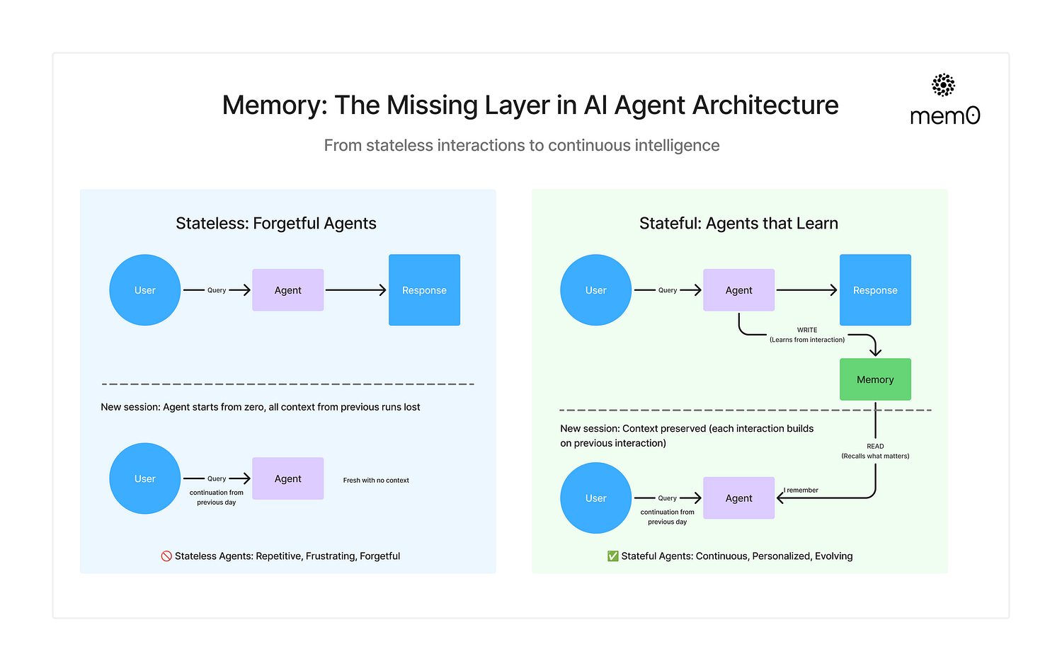

Slide 4
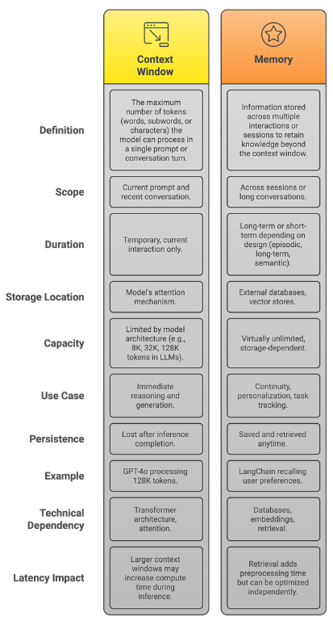

Slide 5
Types of Memory in Agents
At a foundational level, memory in AI agents comes in two forms:
Short-term memory: Holds immediate context within a single interaction.
Long-term memory: Persists knowledge across sessions, tasks, and time.
Just like in humans, these memory types serve different cognitive functions. Short-term memory helps the agent stay coherent in the moment. Long-term memory helps it learn, personalize, and adapt.

Slide 6
Short-term memory
Short-term memory, or thread-scoped memory, can be recalled at any time from within a single conversational thread with a user. State is persisted to a database using a checkpointer so the thread can be resumed at any time.

Slide 7
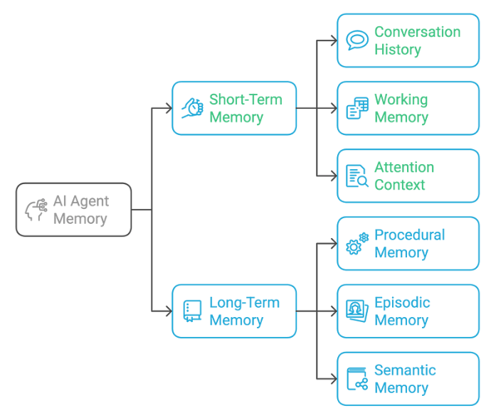

Slide 8
Short-Term Memory (Or Working Memory)
The most basic form of memory in AI systems holds immediate context — like a person remembering what was just said in a conversation. This includes:
Conversation History: Recent messages and their order
Working Memory: Temporary variables and state
Attention Context: Current focus of the conversation

Slide 9
Managing long conversation history with Short term memory
Long conversations pose a challenge to today's LLMs. The full history may not even fit inside an LLM's context window, resulting in an irrecoverable error. Even if your LLM technically supports the full context length, most LLMs still perform poorly over long contexts.
They get "distracted" by stale or off-topic content, all while suffering from slower response times and higher costs.

Slide 10
With short-term memory enabled, long conversations can exceed the LLM’s context window. Common solutions are:
Trimming: Remove first or last N messages (before calling LLM)
Summarization: Summarize earlier messages in the history and replace them with a summary
Delete messages from LangGraph state permanently
custom strategies (e.g., message filtering, etc.)

Slide 11
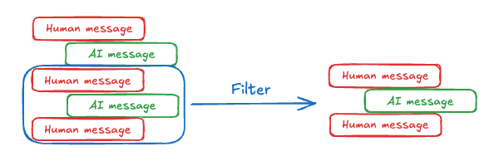
Managing short-term memory for Long Conversation

Slide 12
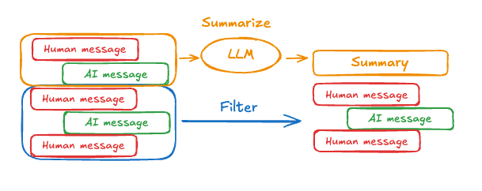
Summarizing past conversations

Slide 13
Long-term memory
Long-term memory allows systems to retain information across different conversations or sessions. Unlike short-term memory, which is thread-scoped, long-term memory is saved within custom "namespaces."

Slide 14
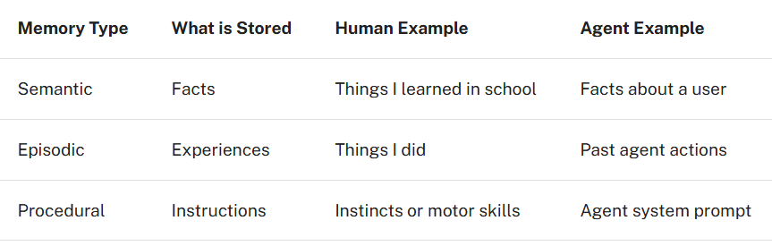
Memory types

Slide 15
Semantic Memory
Semantic memory, both in humans and AI agents, involves the retention of specific facts and concepts. In humans, it can include information learned in school and the understanding of concepts and their relationships. For AI agents, semantic memory is often used to personalize applications by remembering facts or concepts from past interactions.

Slide 16
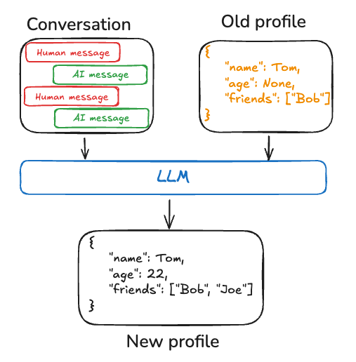
Semantic memory example: Profile

Slide 17
Episodic Memory
Episodic memory, in both humans and AI agents, involves recalling past events or actions. For AI agents, episodic memory is often used to help an agent remember how to accomplish a task.
In practice, episodic memories are often implemented through few-shot example prompting, where agents learn from past sequences to perform tasks correctly.
Sometimes it's easier to "show" than "tell" and LLMs learn well from examples. Few-shot learning lets you "program" your LLM by updating the prompt with input-output examples to illustrate the intended behavior. While various best-practices can be used to generate few-shot examples, often the challenge lies in selecting the most relevant examples based on user input.

Slide 18
Procedural Memory
Procedural memory, in both humans and AI agents, involves remembering the rules used to perform tasks. In humans, procedural memory is like the internalized knowledge of how to perform tasks, such as riding a bike via basic motor skills and balance.
Episodic memory, on the other hand, involves recalling specific experiences, such as the first time you successfully rode a bike without training wheels or a memorable bike ride through a scenic route. For AI agents, procedural memory is a combination of model weights, agent code, and agent's prompt that collectively determine the agent's functionality.

Slide 19
Writing memory
While humans often form long-term memories during sleep, AI agents need a different approach. When and how should agents create new memories? There are at least two primary methods for agents to write memories: “on the hot path” and “in the background”.

Slide 20
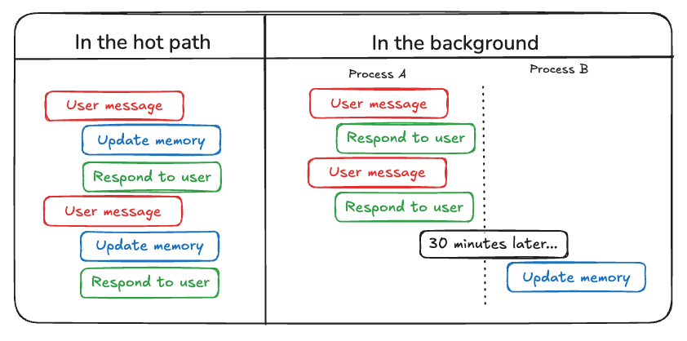

Slide 21
Writing memories in the hot path
Creating memories during runtime offers both advantages and challenges. On the positive side, this approach allows for real-time updates, making new memories immediately available for use in subsequent interactions. It also enables transparency, as users can be notified when memories are created and stored.
However, this method also presents challenges. It may increase complexity if the agent requires a new tool to decide what to commit to memory. In addition, the process of reasoning about what to save to memory can impact agent latency. Finally, the agent must multitask between memory creation and its other responsibilities, potentially affecting the quantity and quality of memories created.
As an example, ChatGPT uses a save_memories tool to upsert memories as content strings, deciding whether and how to use this tool with each user message.

Slide 22
Writing memories in the background
Creating memories as a separate background task offers several advantages. It eliminates latency in the primary application, separates application logic from memory management, and allows for more focused task completion by the agent. This approach also provides flexibility in timing memory creation to avoid redundant work.
However, this method has its own challenges. Determining the frequency of memory writing becomes crucial, as infrequent updates may leave other threads without new context. Deciding when to trigger memory formation is also important. Common strategies include scheduling after a set time period (with rescheduling if new events occur), using a cron schedule, or allowing manual triggers by users or the application logic

